Slide 1

COMPILER DESIGN
Unit 5: Run-Time Environments
Prakash C O
Department of Computer Science and Engineering

Slide 2

COMPILER DESIGN
Unit 4: Run-Time Environments Introduction
Prakash C O
Department of Computer Science and Engineering

Slide 3
COMPILER DESIGN
Unit 5: Run-Time Environments
Introduction
A compiler must accurately implement the abstraction embodied in the source language
definition. These abstractions typically include the concepts such as
Names, Scopes, Bindings,
Data types,
Operators,
Procedures, Parameters, and
Flow-of-Control constructs.
The compiler must cooperate with the Operating System and other System Softwares to support these abstractions on the target machine.
To do so, the compiler creates and manages a run-time environment in which it assumes its target programs are being executed.

Slide 4
COMPILER DESIGN
Unit 5: Run-Time Environments
Introduction
A runtime environment is a set of data structures maintained at runtime to implement
high-level structures such as
Functions,
Objects,
Exceptions,
Data types,
Flow-of-Control constructs, etc., .
Run time environment - Everything you need to execute a program.

Slide 5
COMPILER DESIGN
Unit 5: Run-Time Environments
Introduction
Run-time environment deals with a variety of issues such as
the allocation of storage locations for the objects named in the source program,
the mechanisms used by the target program to access variables,
the linkages between procedures,
the mechanisms for passing parameters, and
the interfaces to the OS, i/o devices, and other programs.

Slide 6
COMPILER DESIGN
Unit 5: Run-Time Environments
Introduction
Many questions to answer regarding execution of functions:
What does the dynamic execution of functions look like?
Where is the executable code for functions located?
How are parameters passed in and out of functions?
Where are local variables stored?
…

Slide 7
COMPILER DESIGN
Unit 5: Run-Time Environments Storage Organization
Prakash C O
Department of Computer Science and Engineering

Slide 8
COMPILER DESIGN
Unit 5: Run-Time Environments
Storage Organization
The compiler deals with logical address space.
OS maps the logical addresses to physical addresses
The representation of an object program (Target Code) in the logical
address space consists of
Program area and
Data area.
Program area(Code)
Data area
Note:
Logical Address Space is set of all logical addresses generated by CPU in reference to a program.
Physical Address (location in a memory unit) is set of all physical addresses mapped to the corresponding logical addresses.

Slide 9
COMPILER DESIGN
Unit 5: Run-Time Environments
Storage Organization
Runtime storage can be subdivided to hold :
Code
Static
Heap
Free Memory
Stack
1. Target code - it is static as its size can be determined at compile time
Heap grows towards higher memory
Static data objects
Dynamic data objects – Heap Memory
Automatic data objects – Stack memory
Stack grows towards lower
memory
Figure 7.1: Subdivision of run-time memory into code and data areas

Slide 10
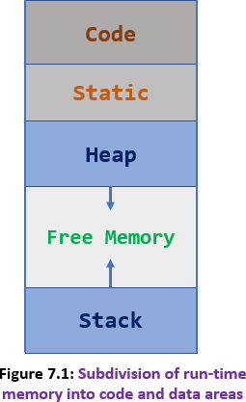
COMPILER DESIGN
Unit 5: Run-Time Environments
Storage Organization
1. Code (Target Machine Code):
The size of the generated target code is fixed at compile time,
So the compiler can place the executable target code in a statically determined area called Code, usually in the low end of memory.

Slide 11
COMPILER DESIGN
Unit 5: Run-Time Environments
Storage Organization
2. Static data objects:
The size of data objects, such as Global Constants are known at compile time, and can be placed in another statically determined area called Static.
Static allocation is possible only when the compiler knows the size of data object at compile time.
Reason for statically allocating as many data objects as possible is that the addresses of these objects can be compiled into the target code.

Slide 12
COMPILER DESIGN
Unit 5: Run-Time Environments
Storage Organization
3. Heap Memory:
To maximize the utilization of space at run time, Stack and Heap, are at the opposite ends of the remainder of the address space.
Stack and Heap areas are dynamic; their size can change as the program executes.
Heap memory is used to dynamically allocate (malloc) memory to the variables and claim it back when the variables are no more required.

Slide 13
COMPILER DESIGN
Unit 5: Run-Time Environments
Storage Organization
4. Stack Memory:
The Stack is used to store data structures called activation records that get generated during procedure calls.
Stack grows with each call and shrinks with each procedure return/terminate.

Slide 14
COMPILER DESIGN
Unit 5: Run-Time Environments
Static Versus Dynamic Storage Allocation
Static allocation:
A storage-allocation decision is static, if it can be made by the compiler looking only at the text of the program, not at what the program does when it executes.
Static allocation
Names are bound to storage locations at compilation time
Bindings do not change, so no run time support is required
Names are bound to the same location on every invocation
Values are retained across activations of a procedure
Limitations
Size of all data objects must be known at compile time
Data structures cannot be created dynamically
Recursive procedures are not allowed

Slide 15
COMPILER DESIGN
Unit 5: Run-Time Environments
Static Versus Dynamic Storage Allocation
Dynamic allocation –Storage allocation decisions are made when the program is running.
Stack storage allocation
Heap storage allocation

Slide 16
COMPILER DESIGN
Unit 5: Run-Time Environments
Storage Organization
Many compilers use some combination of the following two strategies for dynamic storage allocation:
Stack storage.
When a function is called the local variables are stored in a stack, and
it is automatically destroyed once returned.
A stack is used when a variable is not used outside that function.
Stack automatically cleans up the object.
Not easily corrupted
Variables cannot be resized.

Slide 17
COMPILER DESIGN
Unit 5: Run-Time Environments
Storage Organization
Many compilers use some combination of the following two strategies for dynamic storage allocation:
Heap storage.
The heap allows objects or other data elements to obtain storage when they are
created and to return that storage when they are invalidated.
To support heap management, "garbage collection" enables the run-time system to detect useless data elements and reuse their storage, even if the programmer does not return their space explicitly.
Automatic garbage collection is an essential feature of many modern languages

Slide 18
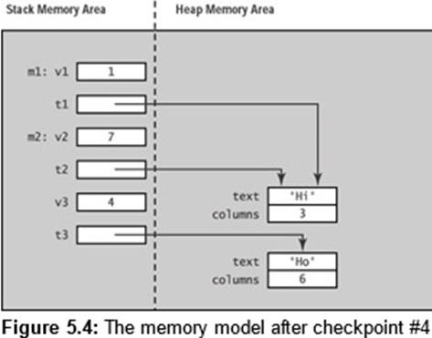
COMPILER DESIGN
Unit 5: Run-Time Environments
Storage Organization Stack Vs Heap Memory
Stack is a linear data structure whereas Heap is a hierarchical data structure.
Stack memory will never become fragmented whereas Heap memory can become fragmented as blocks of memory are first allocated and then freed.
Stack accesses local variables only while Heap allows you to access variables globally.
Stack variables can’t be resized whereas Heap variables can be resized.
Stack memory is allocated in a contiguous block whereas Heap memory is allocated in any random order.
Stack doesn’t require to de-allocate variables whereas in Heap de-allocation
is needed.
Stack allocation and deallocation are done by compiler instructions whereas Heap allocation and deallocation is done by the programmer.

Slide 19
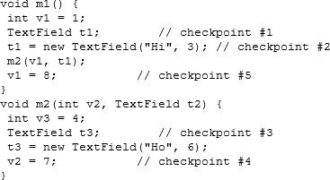
COMPILER DESIGN
Unit 5: Run-Time Environments
Storage Organization
Stack and Heap Storage Allocation: Example
Stack
Heap

Slide 20
COMPILER DESIGN
Unit 5: Run-Time Environments
Storage Organization
Stack and Heap Storage Allocation: Example
Function m1 partial Activation Record.
Function m2 partial Activation Record.

Slide 21
COMPILER DESIGN
Unit 5: Run-Time Environments
Stack Allocation of Space:
Activation Tree & Activation Record
Prakash C O
Department of Computer Science and Engineering

Slide 22
COMPILER DESIGN
Unit 5: Run-Time Environments
Activation Trees
void g() { return 42; }
void f() { return g(); }
main() {
g();
f():
}
Activation:
Each execution of procedure is referred to as an activation.
Activation tree:
A tree structure representing all of the function calls made by a
program on a particular execution.
Activation tree shows the way control enters and leaves
activations.
main
g
f
Activation tree root represents the activation of main.
g

Slide 23
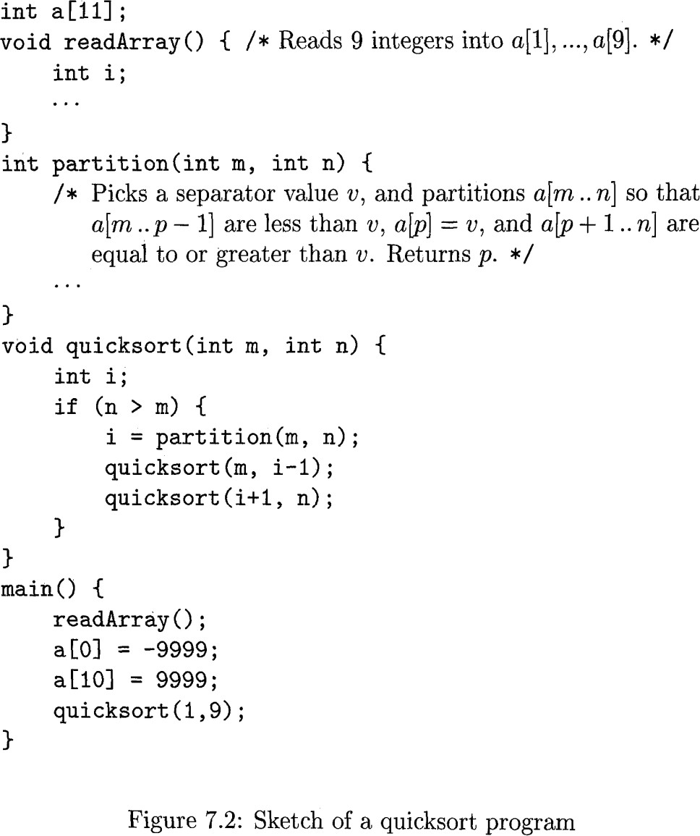
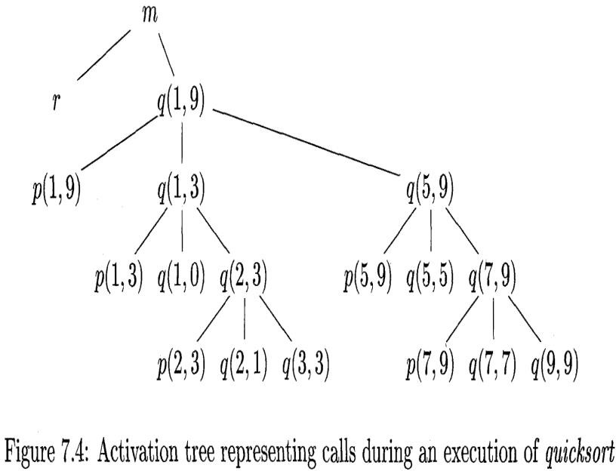
COMPILER DESIGN
Unit 5: Run-Time Environments
Activation Trees
Activation tree:
A representation of the activations of procedures during the running of an entire program by a tree.
Activation tree depends on the runtime behavior of a program; can't always be determined at compile-time.
The static equivalent is the call graph.

Slide 25
COMPILER DESIGN
Unit 5: Run-Time Environments
Activation Trees
main() function call
Properties of activation trees are :-
Each node represents an activation of a procedure.
The root shows the activation of the main function.
Node 𝑎 is the parent of 𝑏 if control flows from 𝑎 to 𝑏
Node 𝑎 is to the left of 𝑏 if lifetime of 𝑎 occurs before 𝑏
Note:
We show these activations in the order that they are called, from left to right.
One child must finish before the activation to its right can begin.

Slide 26
COMPILER DESIGN
Unit 5: Run-Time Environments
Activation Trees
Example:
Figure 7.2 contains a quicksort program that reads 9-integers into an array a and sorts them using the recursive quicksort algorithm.
The main function has three tasks.
Calls readArray,
Sets the sentinels, and then
Calls quicksort on the entire data array.

Slide 27
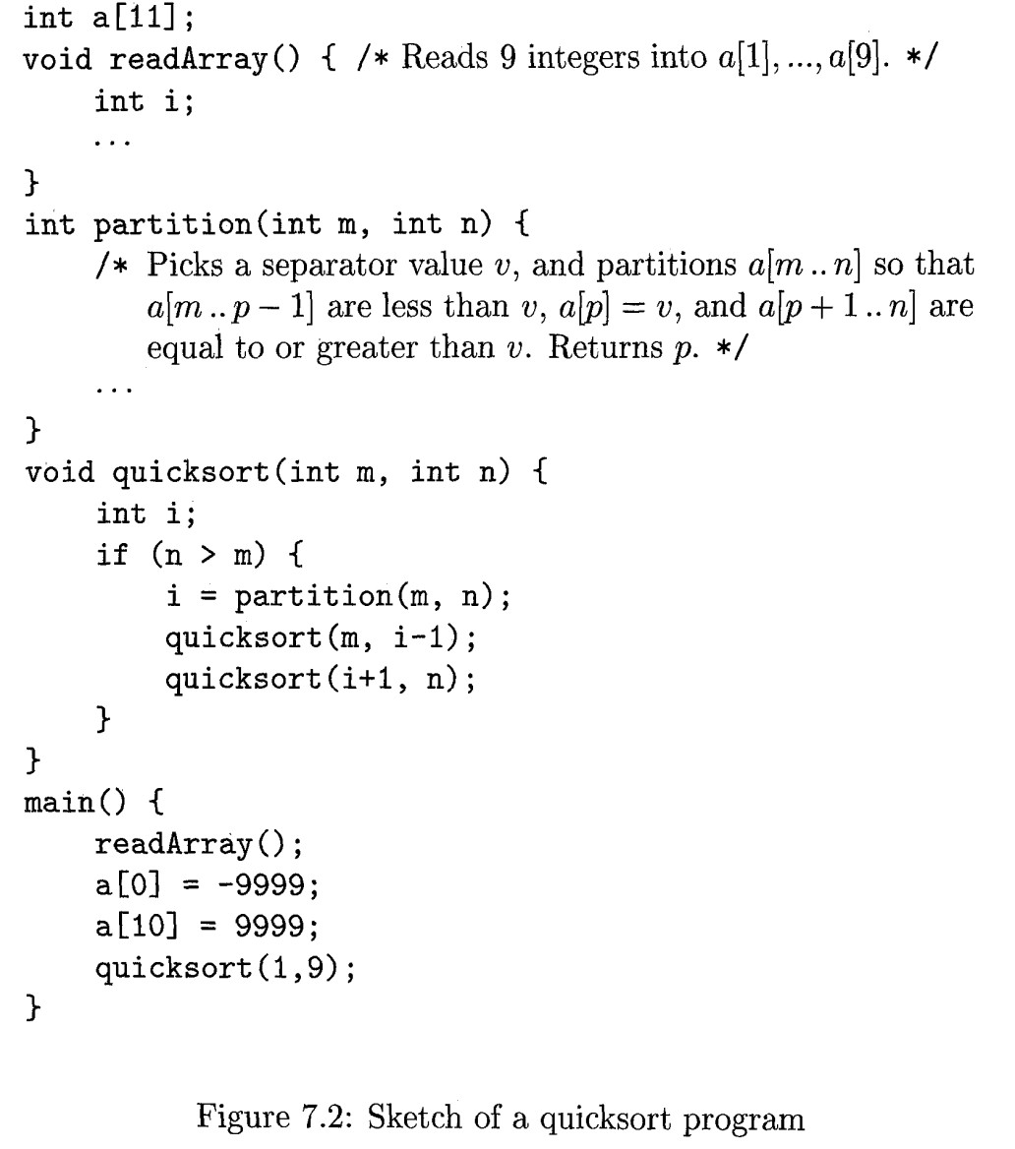
COMPILER DESIGN
Unit 5: Run-Time Environments
Activation Trees
enter main()
enter readArray() leave readArray() enter quicksort(1,9)
enter partition(1,9) leave partition(1,9) enter quicksort(1,3)
...
leave quicksort(1,3) enter quicksort(5,9)
...
leave quicksort(5,9) leave quicksort(1,9)
leave main()
Figure 7.3 suggests a sequence of calls that might result from an execution of the program.
In this execution, the call to partition(1,9) returns 4, so a[1] through a[3] hold elements less than its chosen separator value v, while the larger elements are in a[5] through a[9].
Fig 7.3: Possible activations of Fig 7.2

Slide 28
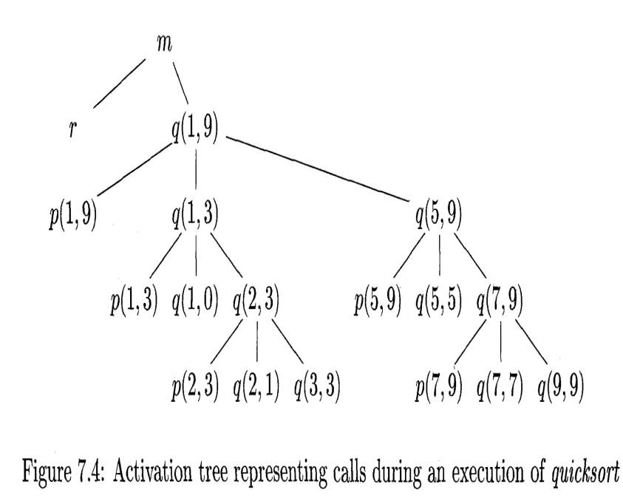
COMPILER DESIGN
Unit 5: Run-Time Environments
Activation Trees
Each execution of procedure is referred to as an activation of the
main() function call
procedure.
Lifetime of an activation is the sequence of steps present in the execution of the procedure.
If ‘a’ and ‘b’ be two procedures, then their activations will be
non-overlapping (when one is called after other) or
nested (nested procedures).
A procedure is recursive if a new activation begins before an earlier activation of the same procedure has ended.

Slide 29
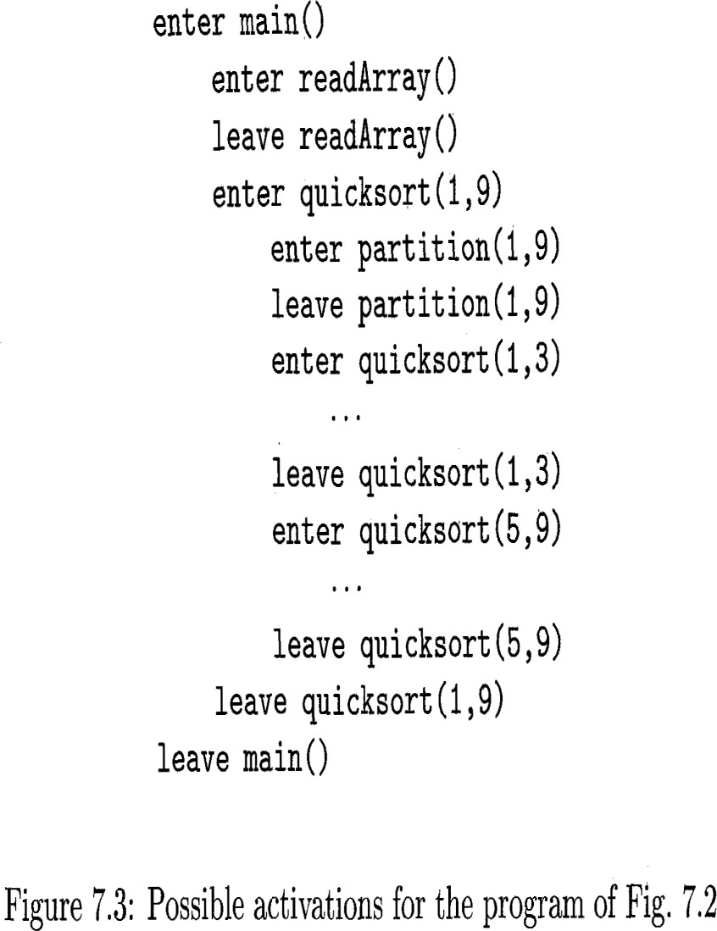
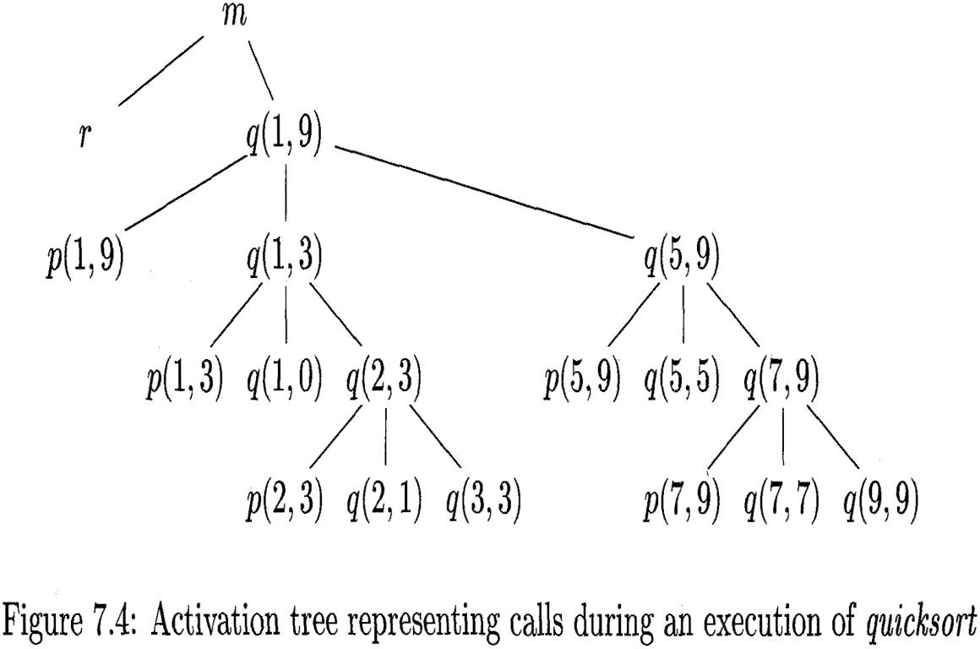
COMPILER DESIGN
Unit 5: Run-Time Environments
Activation Trees

Slide 30
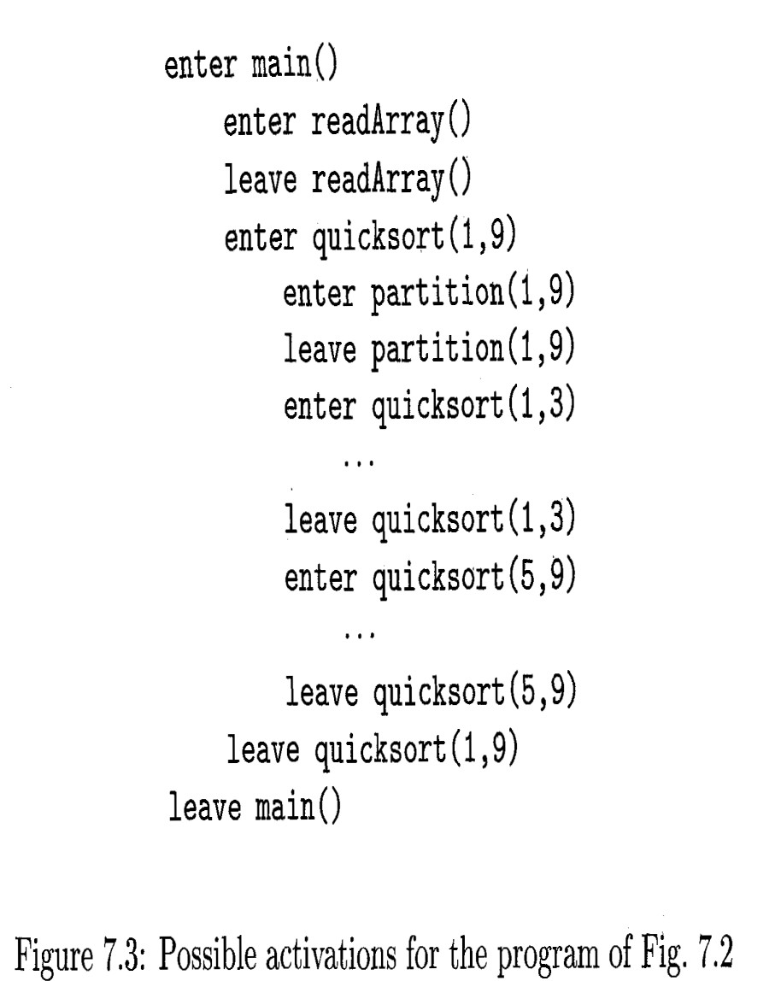
COMPILER DESIGN
Unit 5: Run-Time Environments
Activation Trees
Example: One possible activation tree that completes the sequence of calls and returns suggested in Fig. 7.3 is shown in Fig. 7.4.
Functions are represented by the first
letters of their names.
Remember that this tree is only one possibility, since the arguments of subsequent calls, and also the number of calls along any branch is influenced by the values returned by partition.

Slide 31
COMPILER DESIGN
Unit 5: Run-Time Environments
Activation Trees
The use of a run-time stack is enabled by several useful relationships between the activation tree and the behavior of the program:
The sequence of procedure calls corresponds to a traversal of the activation tree.
The sequence of returns corresponds to a traversal
of the activation tree.
Flow of the control in a program corresponds to a traversal of the activation tree.

Slide 32
COMPILER DESIGN
Unit 5: Run-Time Environments
Activation Trees
The use of a run-time stack is enabled by several useful relationships between the activation tree and the behavior of the program:
The sequence of procedure calls corresponds to a preorder traversal of the activation tree.
The sequence of returns corresponds to a postorder traversal
of the activation tree.
Flow of the control in a program corresponds to a depth-first traversal of the activation tree.

Slide 33
COMPILER DESIGN
Unit 5: Run-Time Environments
Activation Trees
The use of a run-time stack is enabled by several useful relationship between the activation tree and the behavior of the program: cont..
4. If control lies within a particular activation of some procedure,
corresponding to a node N of the activation tree.
Then the activations that are currently open(live) are those that correspond to node N and its ancestors.
s

Slide 34
COMPILER DESIGN
Unit 5: Run-Time Environments
Activation Trees
If an activation of procedure p calls procedure q, then that activation of q must end before the activation of p can end.
p
q
There are three common cases:
The activation of q terminates normally. Then in essentially any language,
control resumes just after the point of p at which the call to q was made.
The activation of q, or some procedure q called, either directly or indirectly, aborts; i.e., it becomes impossible for execution to continue. In that case, p ends simultaneously with q.

Slide 35
COMPILER DESIGN
Unit 5: Run-Time Environments
Activation Trees
If an activation of procedure p calls procedure q, then that activation of q must end before the activation of p can end.
p
q
There are three common cases: cont…
3. The activation of q terminates because of an exception that q cannot handle.
Procedure p may handle the exception, in which case the activation of q has terminated while the activation of p continues, although not necessarily from the point at which the call to q was made.
If p cannot handle the exception, then this activation of p terminates at the same time as the activation of q, and presumably the exception will be handled by some other open activation of a procedure.

Slide 36
Activation Trees
COMPILER DESIGN
Unit 5: Run-Time Environments
Exercise 1: Write Activation tree for the below code.
int main() { Fib(3);
}
int Fib(int n) {
if (n<=1) return n;
return Fib(n-1) + Fib(n-2);
}

Slide 37
Activation Trees
COMPILER DESIGN
Unit 5: Run-Time Environments
Exercise 1: Write Activation tree for the below code.
m
int main() { Fib(3);
}
F(3)
int Fib(int n) {
if (n<=1) return n;
F(2)
F(1)
return Fib(n-1) + Fib(n-2);
F(1)
F(0)
}

Slide 38
COMPILER DESIGN
Unit 5: Run-Time Environments
Activation Trees
Exercise 2: Write Activation tree for the below code.
main()
{
printf(“Enter Your Name: “); scanf(“%s”, username);
show_data(username);
printf(“Press any key to continue…”);
. . .
}
int show_data(char *user)
{ printf(“Your name is %s”, user);
return 0;
}

Slide 39
COMPILER DESIGN
Unit 5: Run-Time Environments
Activation Trees
Exercise 2: Write Activation tree for the below code.
main()
{
main
printf(“Enter Your Name: “); scanf(“%s”, username); show_data(username);
printf(“Press any key to continue…”);
. . .
}
printf
scanf
Show_data
printf
printf
When a procedure is called, its control is transferred to the called procedure. When a called procedure is executed, it returns the control back to the caller.
This type of control flow makes it easier to represent a series of
activations in the form of a tree, known as the activation tree.
int show_data(char *user)
{ printf(“Your name is %s”, user);
return 0;
}

Slide 40
COMPILER DESIGN
Unit 5: Run-Time Environments
Activation Records (or Stack frames)
An activation record is a block of storage that contains all the necessary
information required by a single execution of a procedure.
Actual Parameters
--------------------
Returned values
--------------------
Control Link
--------------------
Access Link
--------------------
Saved machine Status
--------------------
Local data
--------------------
Temporaries
An activation record is used to store Status of the machine (the value of PC and machine registers), Actual Parameters, Return values, Access and Control links, and Local variables, when a procedure call occurs.
Function calls are implemented using a stack of activation records.
Calling a function pushes a new activation record onto the stack.
Returning from a function pops the current activation record from the stack.
Figure 7.5: A general activation record

Slide 41
COMPILER DESIGN
Unit 5: Run-Time Environments
Activation Records (or Stack frames)
When control returns from the called procedure, the activation of the calling procedure can be restarted after restoring the values of relevant registers and setting the program counter to the point immediately after the call.
Actual Parameters
--------------------
Returned values
--------------------
Control Link
--------------------
Access Link
--------------------
Saved machine Status
--------------------
Local data
--------------------
Temporaries
“Once a function returns, its activation record cannot be referenced again.”
Figure 7.5: A general activation record

Slide 42
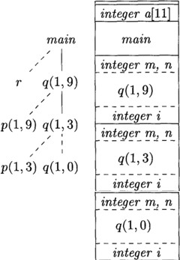
COMPILER DESIGN
Unit 5: Run-Time Environments
Activation Records
Procedure calls and returns are usually managed by a run-time stack called the control stack.
Each live activation has an _ on the control stack, with the root of the activation tree at the bottom.
The entire sequence of activation records on the stack corresponds to the in the activation tree to the activation where control currently resides.
The latter activation has its record at the top of the stack.

Slide 43
COMPILER DESIGN
Unit 5: Run-Time Environments
Activation Records
Procedure calls and returns are usually managed by a run-time stack called the control stack.
Each live activation has an activation record on the control stack, with the root of the activation tree at the bottom.
The entire sequence of activation records on the stack corresponds to the path in the activation tree to the activation where control currently resides.
The latter activation has its record at the top of the stack.

Slide 44

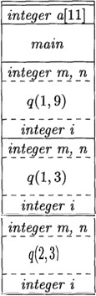
COMPILER DESIGN
Unit 5: Run-Time Environments
Activation Records
Example:
If control is currently in the activation q(2,3) of the tree of Fig. 7.4, then the activation record for q(2,3) is at the top of the control stack.
Just below is the activation record for q(1,3), the parent of q(2,3) in the tree.
Stack bottom
Below that is the activation record q(1,9), and at the bottom is the activation record for m, the main function and root of the activation tree.
Stack top

Slide 45
COMPILER DESIGN
Unit 5: Run-Time Environments
Activation Records
The contents of activation records vary with the language being implemented.
Actual Parameters
--------------------
Returned values
--------------------
Control Link
--------------------
Access Link
--------------------
Saved machine Status
--------------------
Local data
--------------------
Temporaries
A list of the kinds of data that might appear in an activation record are:
1. Temporary values, such as those arising from the evaluation of expressions, in cases where those temporaries cannot be held in registers.
Figure 7.5: A general activation record
2. Local data belonging to the procedure whose activation record this is.

Slide 46
COMPILER DESIGN
Unit 5: Run-Time Environments
Activation Records
A list of the kinds of data that might appear in an activation record are:
Actual Parameters
--------------------
Returned values
--------------------
Control Link
--------------------
Access Link
--------------------
Saved machine Status
--------------------
Local data
--------------------
Temporaries
A saved machine status, with information about the state of the machine just before the call to the procedure.
This information typically includes
return address (value of the program counter) and
contents of registers that were used by the calling procedure and that
must be restored when the return occurs.
Figure 7.5: A general activation record

Slide 47
COMPILER DESIGN
Unit 5: Run-Time Environments
Activation Records
4. An "access link" may be needed to locate data needed by the called procedure but found elsewhere, e.g., in another activation record.
It refers to information stored in other activation records that is non-local. The access link is a static link and the main purpose of the access link is to access the data which is not present in the local scope of the activation record. It is a static link.
Actual Parameters
--------------------
Returned values
--------------------
Control Link
--------------------
Access Link
--------------------
Saved machine Status
--------------------
Local data
--------------------
Temporaries
#include <stdio.h>
int g=12;
void Geeks()
{
printf("%d", g);
}
void main()
{
Geeks();
}
Now, In this example, when Geeks() is called in a main(), the task of Geeks() in main() is to print(g), but g is not defined within its scope(local scope of Geeks()); in this case, Geeks() would use the access link to access ‘g’ from Global Scope and then print its value (g=12).
Figure 7.5: A general activation record

Slide 48
COMPILER DESIGN
Unit 5: Run-Time Environments
Activation Records
5. A control link, pointing to the activation record of the caller.
Actual Parameters
--------------------
Returned values
--------------------
Control Link
--------------------
Access Link
--------------------
Saved machine Status
--------------------
Local data
--------------------
Temporaries
6. Space for the return value of the called function, if any.
Again, not all called procedures return a value, and if one does, we may prefer to place that value in a register for efficiency.
7. The actual parameters used by the calling procedure.
Commonly, these values are not placed in the activation record but rather in registers, when possible, for greater efficiency. However, we show a space for them to be completely general.
https://www.geeksforgeeks.org/access-links-and-control-links/
Figure 7.5: A general activation record

Slide 49
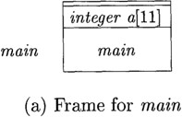
COMPILER DESIGN
Unit 5: Run-Time Environments
Activation Records
Example 7.4: Figure 7.6 shows snapshots of the run-time stack as
control flows through the activation tree of Fig. 7.4.
Since array a is global, space is allocated for it before execution begins with an activation of procedure main, as shown in Fig. 7.6(a).
Figure 7.6: Downward-growing stack of activation records

Slide 50
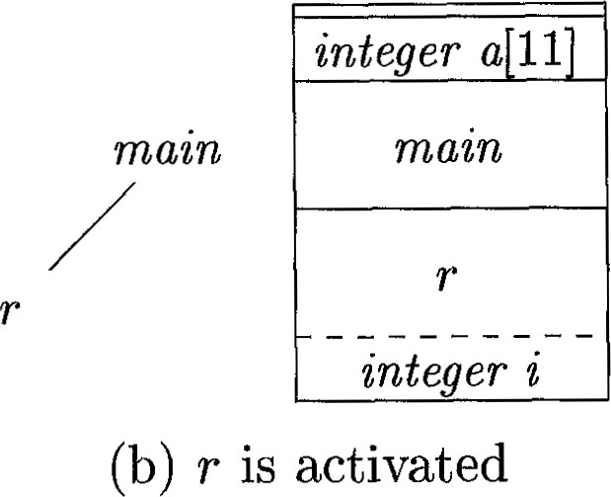
COMPILER DESIGN
Unit 5: Run-Time Environments
Activation Records
Example 7.4: cont…
When control reaches the first call in the body of main, procedure r is activated, and its activation record is pushed onto the stack (Fig. 7.6(b)).
The activation record for r contains space for local variable i. When control returns from this activation, its record is popped, leaving just the record for main on the stack.
Figure 7.6: Downward- growing stack of activation records

Slide 51
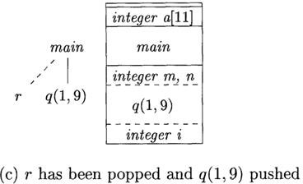
COMPILER DESIGN
Unit 5: Run-Time Environments
Activation Records
Example 7.4: cont…
Control then reaches the call to q (quicksort) with actual parameters 1 and 9, and an activation record for this call is placed on the top of the stack, as in Fig. 7.6(c).
The activation record for q contains
space for the parameters m and n and the local variable i, following the general layout in Fig. 7.5.
Figure 7.6: Downward-growing
stack of activation records

Slide 52
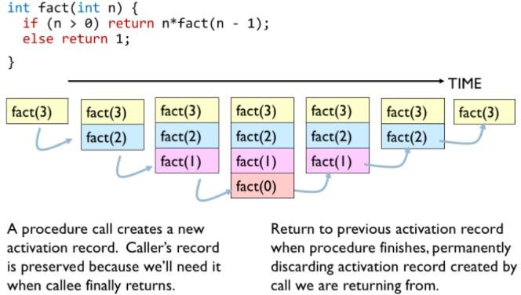
COMPILER DESIGN
Unit 5: Run-Time Environments
Activation Records
Notice that when a procedure is recursive, it is normal to have several of its
activation records on the stack at the same time.
Example:

Slide 53
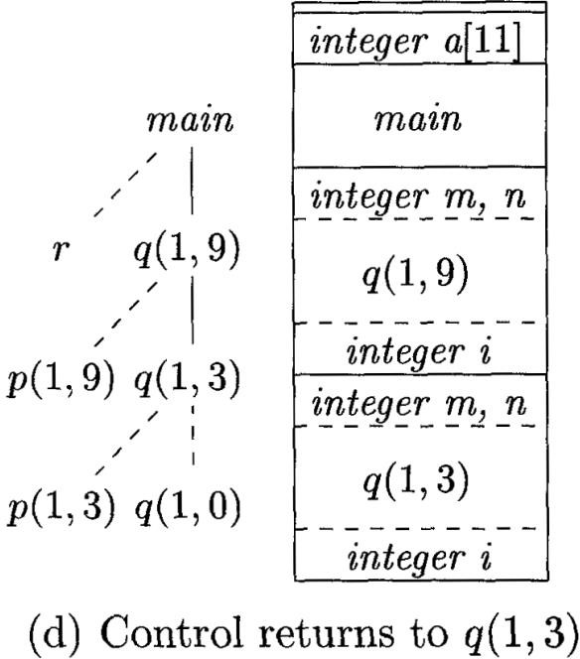
COMPILER DESIGN
Unit 5: Run-Time Environments
Activation Records
Example 7.4: cont…
Several activations occur between the last two snapshots in Fig. 7.6. A recursive call to q(1,3) was made. Activations p(1,3) and q(1,0) have begun and ended during the lifetime of q(1,3), leaving the activation record for q(1,3) on top (Fig. 7.6(d)).
Notice that when a procedure is recursive, it is normal to have several of its activation records on the stack at the same time.
Figure 7.6: Downward-growing stack of activation records

Slide 54
COMPILER DESIGN
Unit 5: Run-Time Environments
Stack Allocation of Space: Calling Sequence and Return Sequence
Prakash C O
Department of Computer Science and Engineering

Slide 55
COMPILER DESIGN
Unit 5: Run-Time Environments
Calling Sequence and Return sequence
Calling Sequence (is a code sequence)
Procedure calls are implemented by what are known as Calling Sequences.
Calling sequence is a code sequence that allocates an activation record on the stack and enters information into its fields.
Return Sequence (is a code sequence)
A return sequence is similar code to restore the state of the machine so the calling procedure can continue its execution after the call.

Slide 56
COMPILER DESIGN
Unit 5: Run-Time Environments
Calling Sequences
Calling sequences and the layout of activation records may differ greatly, even among implementations of the same language.
The code in a calling sequence is often divided between the calling procedure
(the "caller") and the procedure it calls (the "callee").
Responsibility is shared between the caller and the callee
There is no exact division of run-time tasks between caller and callee;
the source language, the target machine, and the operating system impose requirements that may favor one solution over another.

Slide 57
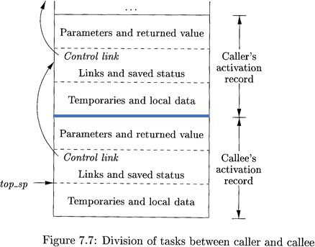
COMPILER DESIGN
Unit 5: Run-Time Environments
Calling Sequences
Actual Parameters
--------------------
Returned values
--------------------
Control Link
--------------------
Access Link
--------------------
Saved machine Status
--------------------
Local data
--------------------
Temporaries
When designing calling sequences and the layout of activation records,
the following principles are helpful:
1. Values communicated between caller and callee are generally placed at the beginning of the callee’s activation record, so they are as close as possible to the caller's activation record.
Figure 7.5: A general activation record
The motivation is that the caller can compute the values of the actual parameters of the call and place them on top of its own activation record, without having to create the entire activation record of the callee, or even to know the layout of that record.
The callee knows where to place the return value, relative to its own activation record, while however many arguments are present will appear sequentially below that place on the stack.

Slide 58
COMPILER DESIGN
Unit 5: Run-Time Environments
Calling Sequences
Actual Parameters
--------------------
Returned values
--------------------
Control Link
--------------------
Access Link
--------------------
Saved machine Status
--------------------
Local data
--------------------
Temporaries
2. Fixed-length items are generally placed in the middle, such items typically include the control link, the access link, and the machine status fields.
Figure 7.5: A general activation record
If exactly the same components of the machine status are saved for each call, then the same code can do the saving and restoring for each.

Slide 59
COMPILER DESIGN
Unit 5: Run-Time Environments
Calling Sequences
Actual Parameters
--------------------
Returned values
--------------------
Control Link
--------------------
Access Link
--------------------
Saved machine Status
--------------------
Local data
--------------------
Temporaries
Items whose size may not be known early enough are placed at the
end of the activation record.
Most local variables have a fixed length, which can be determined by the compiler by examining the type of the variable.
Some local variables have a size that cannot be determined until the
program executes.
Example: Dynamically sized array, where the value of one of the
callee's parameters determines the length of the array.
The amount of space needed for temporaries usually depends on how successful the code-generation phase is in keeping temporaries in registers.
Figure 7.5: A general activation record

Slide 60
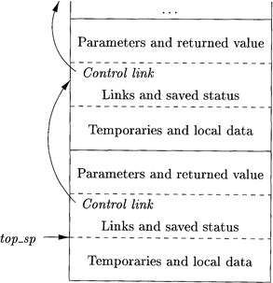
COMPILER DESIGN
Unit 5: Run-Time Environments
Calling Sequences
Top-of-stack (i.e., top_sp) points to the end of the fixed-length fields
in the activation record.
Fixed-length data can then be accessed by fixed offsets, known to the intermediate-code generator, relative to the top-of-stack pointer.
Variable-length fields in the activation records are actually "above" the top-of-stack. Their offsets need to be calculated at run time, but they too can be accessed from the top-of stack pointer, by using a positive offset.

Slide 61
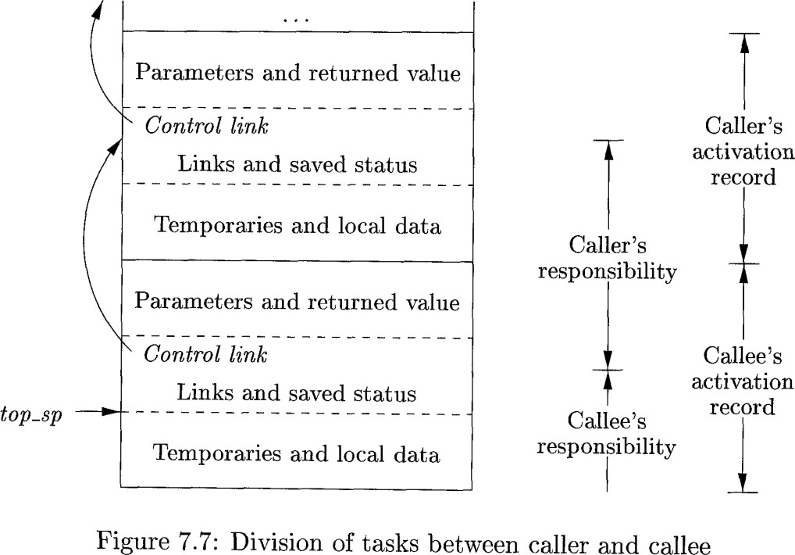
COMPILER DESIGN
Unit 5: Run-Time Environments
Calling Sequences
An example of how caller and callee might cooperate in managing the stack is suggested by Fig. 7.7.
A register top-sp points to the end of the machine status
field in the current top activation record.
The top-sp pointer position within the callee‘s activation record is known to the caller, so the caller can be made responsible for setting top-sp before control is passed to the callee.

Slide 62
COMPILER DESIGN
Unit 5: Run-Time Environments
Calling Sequences
The calling sequence and its division between caller and callee is as follows:
1. The caller evaluates the actual parameters and stores them in the beginning of callee's activation record.
top-sp
The caller stores a return address into the callee's activation record.
The caller stores the old value of top-sp into the callee's activation record (i.e., in control link field)
The caller then increments top-sp to the position shown in Fig. 7.7.
That is, top-sp is moved past the caller's local data and temporaries and the callee's parameters and status fields.The callee saves the register values and other status information.The callee initializes its local data and begins execution.

Slide 63
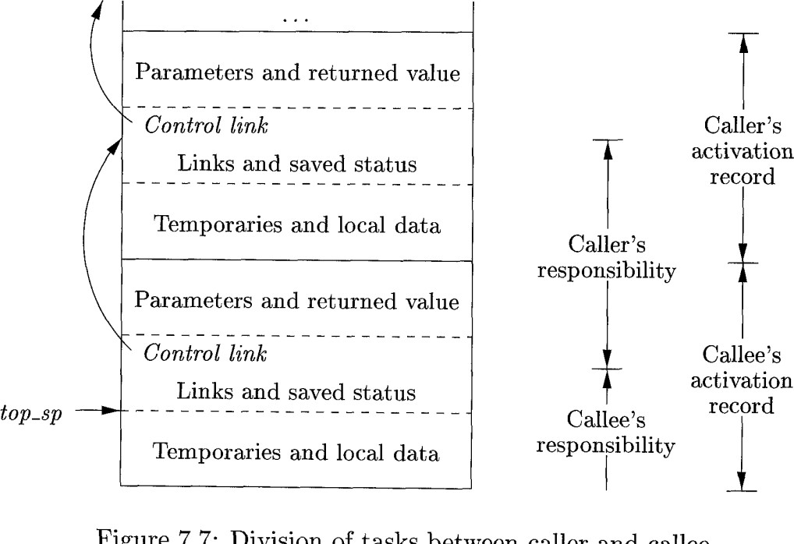

COMPILER DESIGN
Unit 5: Run-Time Environments
Calling Sequences
Actual Parameters
--------------------
Returned values
--------------------
Control Link
--------------------
Access Link
--------------------
Saved machine Status
-------------------
Local data
--------------------
Temporaries
A return sequence is:
1. The callee places the return value next to the parameters, as in Fig. 7.5.
Figure 7.5: A general activation record
2. Using information in the machine-status field, the callee restores top-sp and other registers, and then branches to the return address that the caller placed in the status field.
top-sp
3. Although top-sp has been decremented, the caller knows where the return value is, relative to the current value of top-sp; the caller therefore may use that value.
top-sp

Slide 64
COMPILER DESIGN
Unit 5: Run-Time Environments
Stack Allocation of Space: Variable-Length Data on the Stack
Prakash C O
Department of Computer Science and Engineering

Slide 65
COMPILER DESIGN
Unit 5: Run-Time Environments
Variable-Length Data on the Stack
The run-time memory-management system must deal frequently with the allocation of space for objects the sizes of which are not known at compile time, but which are local to a procedure and thus may be allocated on the stack.
int foo(int x, int y)
{
int m, n, *p;
p = (int *)malloc(sizeof(int)*x);
…
…
}
For example, a local array whose size depends upon a parameter
In modern languages, objects whose size cannot be determined at compile time are allocated space in the heap but would require garbage collection.

Slide 66
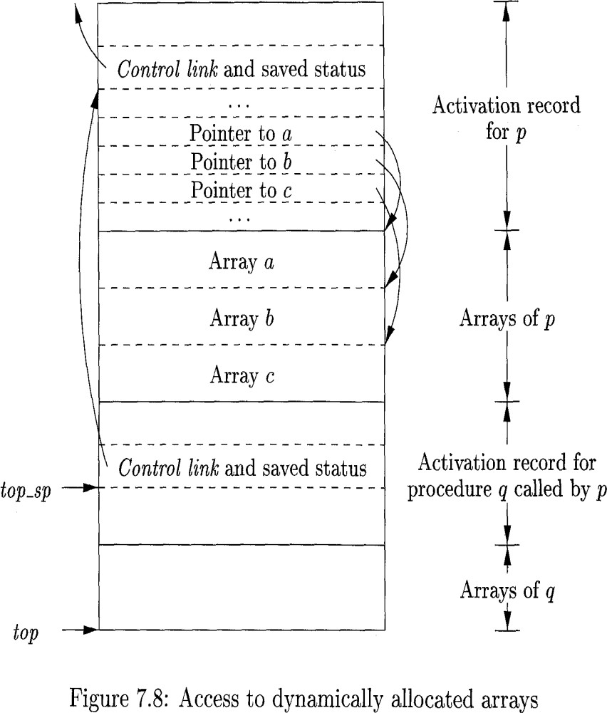
COMPILER DESIGN
Unit 5: Run-Time Environments
Variable-Length Data on the Stack
A common strategy for allocating variable-length
arrays is shown in Fig.
(variable-length arrays are arrays whose size depends on the value
of one or more parameters of the called procedure)
A register top-sp points to the end of the machine status field in the current top activation record.

Slide 67
COMPILER DESIGN
Unit 5: Run-Time Environments
Variable-Length Data on the Stack
In Fig. 7.8, Procedure p has three local arrays, whose sizes we
suppose cannot be determined at compile time.
The storage for these arrays is not part of the activation record for p, although it does appear on the stack.
Only a pointer to the beginning of each array appears in the activation
record itself.
When p is executing, these pointers are at known offsets from the top- of-stack pointer, so the target code can access array elements through these pointers.
Also shown in Fig. 7.8 is the activation record for a procedure q, called by p. The activation record for q begins after the arrays of p, and any variable-length arrays of q are located beyond that.

Slide 68
COMPILER DESIGN
Unit 5: Run-Time Environments
Variable-Length Data on the Stack
Access to the data on the stack is through two pointers, top and
top-sp.
top-sp is used to find local, fixed-length fields of the top activation record.
top marks the actual top of stack; it points to the position at
which the next activation record will begin.
In Fig. 7.8, top-sp points to the end of this field in the activation record for q. From there, we can find the control-link field for q, which leads us to the place in the activation record for p where top-sp pointed when p was on top.

Slide 69
COMPILER DESIGN
Unit 5: Run-Time Environments
Variable-Length Data on the Stack
The code to reposition top and top-sp can be generated at compile time, in terms of sizes that will become known at run time.
When q returns,
The top-sp can be restored from the saved in the activation record for q.
The new value of top is minus the length of the
in q's activation record. This length is known at compile time to the caller, although it may depend on the caller, if the number of parameters can vary across calls to q.

Slide 70
COMPILER DESIGN
Unit 5: Run-Time Environments
Variable-Length Data on the Stack
The code to reposition top and top-sp can be generated at compile time, in terms of sizes that will become known at run time.
When q returns,
The top-sp can be restored from the saved control link in the activation record for q.
The new value of top is top-sp minus the length of the machine-status, control and access link, return-value, and parameter fields (as in Fig. 7.5) in q's activation record.
This length is known at compile time to the caller, although it may depend on the caller, if the number of parameters can vary across calls to q.

Slide 71
COMPILER DESIGN
Unit 5: Run-Time Environments Access to Nonlocal Data on the Stack
Prakash C O
Department of Computer Science and Engineering

Slide 72
COMPILER DESIGN
Unit 5: Run-Time Environments
Access to Nonlocal Data on the Stack
Let’s discuss how the procedures access their data.
Local data – For a procedure p, data that belongs to p.
A variable created inside a function belongs to the local scope of that function, and can only be used inside that function.
Nonlocal data – Data used within a procedure p, but doesnot belong to p.
Example: A variable used within a procedure p, but defined in procedure q.
Access becomes even more difficult when procedures can be declared inside
other procedures. Example: ML language – supports nested functions

Slide 73
COMPILER DESIGN
Unit 5: Run-Time Environments
Data Access Without Nested Procedures
In C and it’s family of languages, there is no problem of nested
procedures. But the data can have nested scopes(blocks).
Simple rules:
Global constants are allocated static storage.
Their locations(addresses) remain fixed and determined at compile time and hence to access these (not local to any procedure) we can use statically determined address.
Actual Parameters
--------------------
Returned values
--------------------
Control Link
--------------------
Access Link
--------------------
Saved machine Status
-------------------
Local data
--------------------
Temporaries
Data that is local to the procedure is at the activation record at the top of the stack, can be accessed using top_sp pointer of the stack.
Figure 7.5: A general activation record

Slide 74
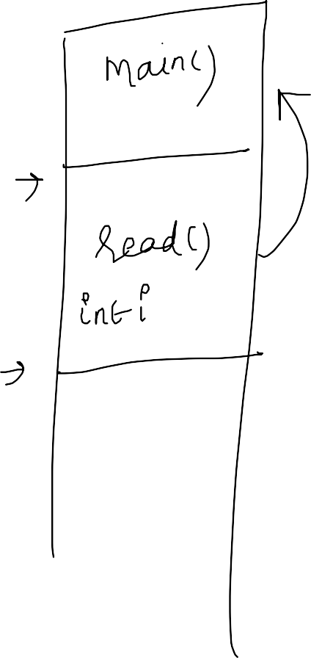
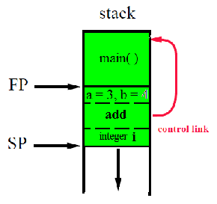
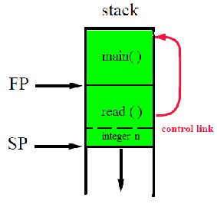
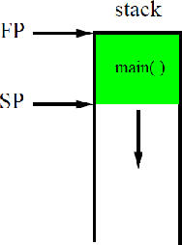



Activation Record (Ex 1)
main(){
read();
add(3, 4);
}
read(){ int n;
…
return;
}
add(a, b) { int i;
…
}
Preet Kanwal

Slide 75
COMPILER DESIGN
Unit 5: Run-Time Environments
Access to Nonlocal data in Nested Procedures
Access becomes difficult when a language allows nested procedures,
i.e a procedure can access variables whose declarations surround it’s
own declarations.
q
int x;
p
Reason:
If p is within q, relative positions of their activation records at compile
time cannot be determined(it’s a dynamic decision).
int y =x+1;
p maybe recursive or q maybe recursive or both p and q maybe recursive. This can lead to several activation records of p and q on the stack.

Slide 76
Access to Nonlocal data in Nested Procedures
COMPILER DESIGN
Unit 5: Run-Time Environments
Suppose x is a nonlocal name used in nested procedure p, finding
it’s declaration is a static decision.
But if x is defined in q, finding relevant activation of q from an activation of p is a dynamic decision.
q
int x=10;
……
……
p
It requires additional run-time information about activations.
y=x+1;
….
Two common strategies: access links and displays

Slide 77
COMPILER DESIGN
Unit 5: Run-Time Environments
ML : Language with Nested Procedure Declarations
ML ("Meta Language") is a general-purpose functional programming language.
ML is statically-scoped i.e., once the variables are declared and initialized it cannot change.
Defining variables
val <name> = <expression>
A declaration introduced with keyword val, allows us to give a name of our choice to the expression. A variable is introduced by binding it to a value as follows:
output
output
Note: - (hyhen) is ML prompt, Notice that the expression to be evaluated is terminated by a semicolon.
- val | x | = | 4*5;
val | x | = | 20 : int
- val | s | = | "Abc" ^ "def";
val | s | = | "Abcdef" : string

Slide 78
COMPILER DESIGN
Unit 5: Run-Time Environments
ML : Language with Nested Procedure Declarations
Declaring functions
fun <name> ( <arguments> ) = < body >
Examples: fun inc x = x+1;
fun double x = 2*x;
fun adda s = s ^ “a”;
To execute a function simply give the function name followed by the actual argument. For example:
- double 6;
- inc 100;
- adda “Indi";
output: output: output:
12 : int
101 : int
“India” : string

Slide 79
COMPILER DESIGN
Unit 5: Run-Time Environments
ML : Language with Nested Procedure Declarations
For function bodies it is of the form ;
let <list of definitions> in <statements> end
The scope of definitions is upto the in and till the end.

Slide 80
COMPILER DESIGN
Unit 5: Run-Time Environments
ML : Language with Nested Procedure Declarations
Functions are not restricted to using parameters and local variables - they may freely refer to variables that are available when the function is defined.
Consider the following definition:
fun pairwith(x,l) =
let
fun p y = (x,y) ----//nested fuction
in
map p l end;
- pairwith(“Hi",l); Note: l=[1,2,3]
[(“Hi",1),(“Hi",2),(“Hi",3)] : ( string * int ) list
The local function p has a non-local reference to the identifier x, the parameter of the function pairwith. The same rule applies here as with other non-local references: the nearest enclosing binding is used.

Slide 81
COMPILER DESIGN
Unit 5: Run-Time Environments
ML : Language with Nested Procedure Declarations
ML supports higher-order functions
Takes functions as arguments
Can construct functions
Can return other functions
ML has no iteration
Effect of iteration is achieved through recursion. for(i=0;i<10;i++)
ML makes i a function argument and calls itself until i is reached.

Slide 82
COMPILER DESIGN
Unit 5: Run-Time Environments
ML : Language with Nested Procedure Declarations
ML takes lists and labelled tree structures as primitive data types.
ML doesnot require declaration of it’s data types.
It recognizes types at compile time.
For example :
var x = 1 is taken to be an integer.
var y = 2.3 * x is taken to be float.

Slide 83
COMPILER DESIGN
Unit 5: Run-Time Environments
Nesting Depth
Procedures not nested within other procedures have nesting depth 1
For example, all functions in C have depth 1
If 𝑝 is defined immediately within a procedure at depth 𝑖, then 𝑝 is at depth 𝑖+1

Slide 84
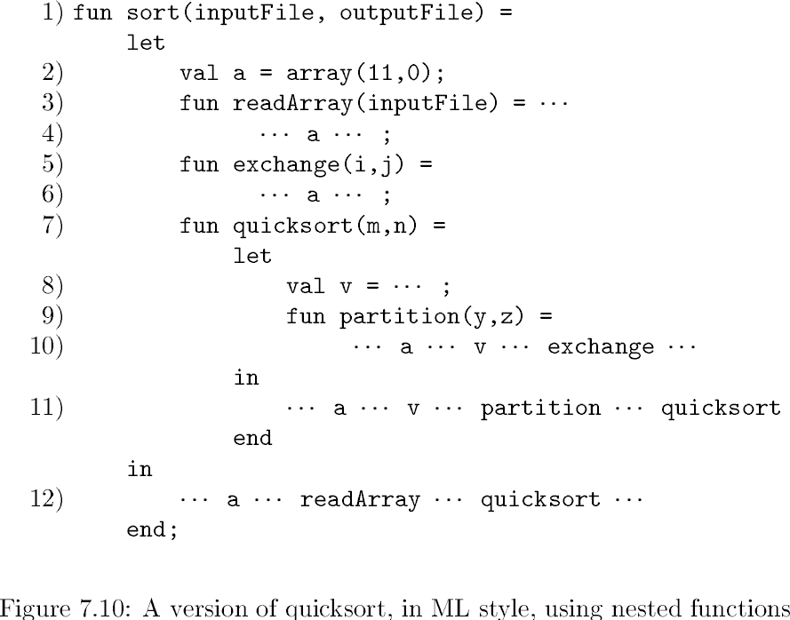
COMPILER DESIGN
Unit 5: Run-Time Environments
Nesting Depth
Quicksort in ML using Nested Procedures
Procedure | Nesting depth
sort
readarray
excahnge
quicksort
partition
Procedures not nested within other procedures
have nesting depth 1
For example, all functions in C have depth 1
If 𝑝 is defined immediately within a procedure at depth 𝑖, then 𝑝 is at depth 𝑖+1

Slide 85
COMPILER DESIGN
Unit 5: Run-Time Environments
Nesting Depth
Quicksort in ML using Nested Procedures
Procedure | Nesting depth
sort | 1
readarray | 2
excahnge | 2
quicksort | 2
partition | 3
Procedures not nested within other procedures
have nesting depth 1
For example, all functions in C have depth 1
If 𝑝 is defined immediately within a procedure at depth 𝑖, then 𝑝 is at depth 𝑖+1

Slide 86
COMPILER DESIGN
Unit 5: Run-Time Environments Access to Nonlocal Data on the Stack:
Access Links and Displays
Prakash C O
Department of Computer Science and Engineering

Slide 87

COMPILER DESIGN
Unit 5: Run-Time Environments
Access Links
Access links form a chain from the activation record at the top of the stack to a sequence of activations at progressively lower nesting depths.
Along this chain are all the activations whose data and procedures are accessible to the currently executing procedure.
Example of Access Links
sort
access link
a
quicksort(1,9)
access link
v
Why?
. . .
Because sort called quicksort?

Slide 88
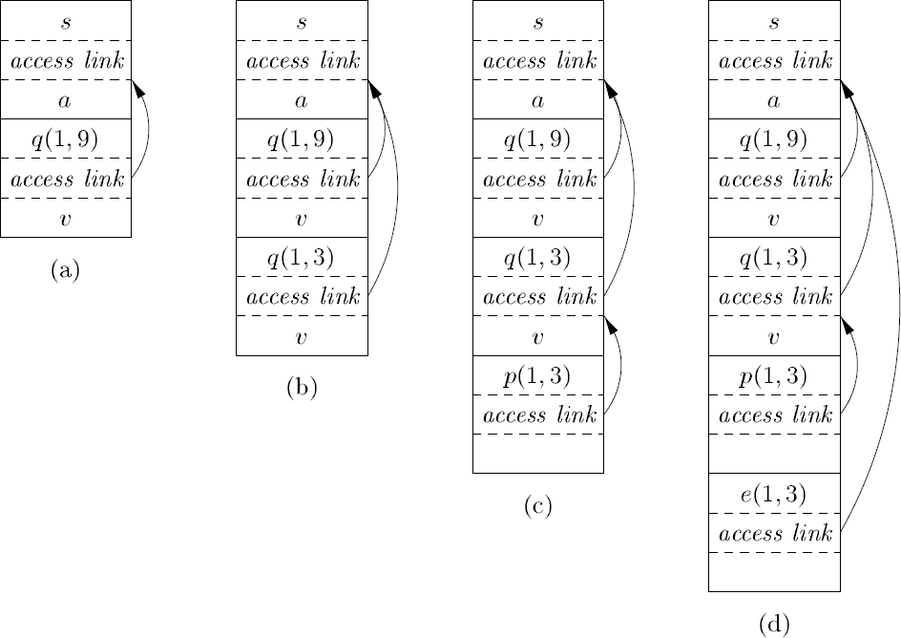
COMPILER DESIGN
Unit 5: Run-Time Environments
Access Links
The normal static scope rule for nested functions is obtained by adding a pointer called the access link to each activation record.
If procedure p is nested immediately within procedure q in the source code, then the access link in any activation of p points to the most recent activation of q.
Note that the nesting depth of q must be exactly one less than the nesting depth of p.
Actual Parameters
--------------------
Returned values
--------------------
Control Link
--------------------
Access Link
--------------------
Saved machine Status
-------------------
Local data
--------------------
Temporaries
Figure 7.5: A general
activation record
q
p
m

Slide 89
COMPILER DESIGN
Unit 5: Run-Time Environments
Access Links
Access links form a chain from the activation record at the top of the stack to a sequence of activations at progressively lower nesting depths.
Along this chain are all the activations whose data and procedures are accessible to the currently executing procedure.
Example of Access Links
sort
access link
a
quicksort(1,9)
access link
v
Why?
. . .
Because sort called quicksort?
No, because sort is the most closely
nesting function surrounding quicksort

Slide 90
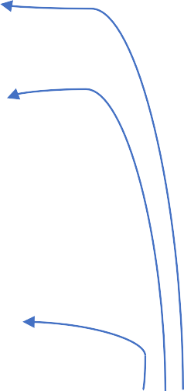
COMPILER DESIGN
Unit 5: Run-Time Environments
Access Links
Example of Access Links
CL
CL
CL CL
Because sort is the most closely nesting
function surrounding quicksort and exchange
Figure 7.11: Access links for finding nonlocal data

Slide 91
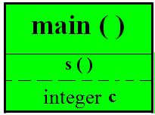
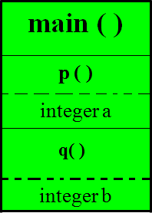
















main(){
Activation Record (Ex 2)
p(){
int a; q(){
int b
...
} q();
}
C_{C}L_{L}
s(){
int c;
...
}
CL
p();
s();
}

Slide 92
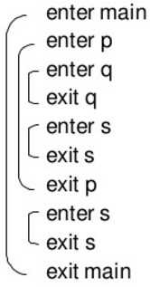
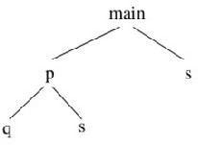
Provide possible activations for the following program and activation tree
fun main() = let
fun s() =
… ….fun p() =
let
fun q() =
…. ……
in
… q
… s
end
in
… p()
… s()
end

Slide 93
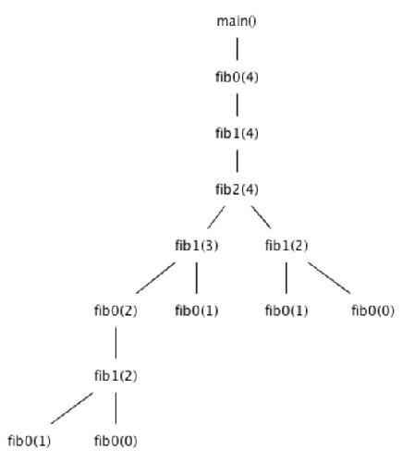
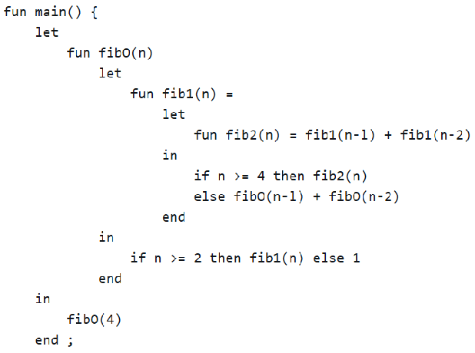
Provide possible activations for the following program and activation tree

Slide 94
Access Link : Example 1
main(){
// ND(main) = 1
p(){
// ND(p) = 2
int z, y = 2; int q(int a){ if (a=1)
return 1; else
// ND(q) = 3
return(a + y + q(a-1));
}
z = q(3);
}
p();
}

Slide 95


main
p z, y : 2
a : 3 q(3) uses y
a : 2 q(2) uses y
a : 1 q(1)
CL
CL
AL
CL
AL
CL
AL

Slide 96
Access Link : Example 2
main(){
int a; p()
{
int d; a = 1;
}
q(int i)
{
int b; s()
{
int c; p();
}
if (i !=0 )
q( i – 1)
else
s();
} q(1)
}

Slide 97




main(){
int a; p()
{
int d; a = 1;
}
q(int i)
{
int b; s()
{
int c; p();
}
if (i !=0 )
q( i – 1)
else
s();
} q(1)
}
Main is defining p and q, therefore AL of p and q is connected to main.
And q() is defining s(), therefore AL of s() is connected to q()
main a
param i : 1 q(1) b
param i : 0 q(0) b
s() c
p () d t Kanwal
CL
AL
AL
CL
CL
AL
AL
CL
Pree

Slide 98
COMPILER DESIGN
Unit 5: Run-Time Environments
Access Links
Suppose procedure p at the top of the stack and has nesting depth n_{p}, and p needs to access x, which is an element defined within some procedure q that surrounds p and has nesting depth n_{q}.
Usually n_{q} < n_{p}, n_{q} == n_{p} only if p and q are the same procedure.
To find x, we start at the activation record for p at the top of the stack and follow the access link n_{p} - n_{q} times, from activation record to activation record.
Finally, we wind up at an activation record for q, this activation record
contains the element x that we want.

Slide 99
COMPILER DESIGN
Unit 5: Run-Time Environments
Manipulating Access Links
How are access links determined? what should happen when a
procedure q calls procedure p, explicitly. There are two cases:
Case 1: n_{q} < n_{p} (Procedure p is at a higher nesting depth than q)
Called procedure 𝑝 is nested within 𝑞
Therefore, 𝑝 must be declared in 𝑞, or the call by 𝑞 will not be within the scope of 𝑝
Access link in 𝑝 should point to the access link of the
activation record of the caller 𝑞

Slide 100
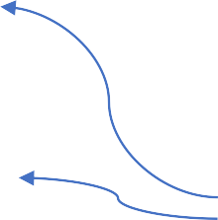
COMPILER DESIGN
Unit 5: Run-Time Environments
Manipulating Access Links
Case 2: n_{p} == n_{q}
Procedures are at the same nesting level
Access link of called procedure 𝑝 is the same as 𝑞
Nesting depth of exchange is 2
Nesting depth of quicksort is 2
Access link of called procedure exchange
is the same as quicksort

Slide 101
COMPILER DESIGN
Unit 5: Run-Time Environments
Access links for Procedure Parameters
When a procedure p is passed to another procedure q as parameter, q may not
know the context in which p appears and its impossible to set access link for p.
Solution: when procedures are used as parameters, the caller needs to pass proper access link to the parameter along with name of procedure parameter.
Caller always knows the link. i.e, in the above case p must be a name accessible to q, therefore q determines access link for p exactly as if p being called by r directly
r ( ) {
q ( p() )
}

Slide 102
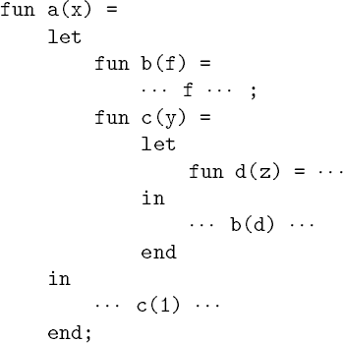
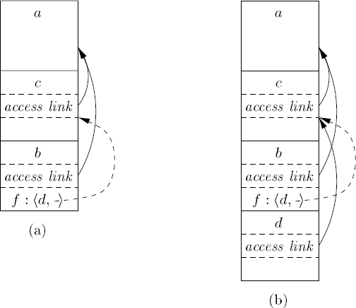
COMPILER DESIGN
Unit 5: Run-Time Environments
Access links for Procedure Parameters
Figure 7.12: Sketch of ML program that
uses function-parameters
Figure 7.13: Actual parameters carry their access link with them

Slide 103
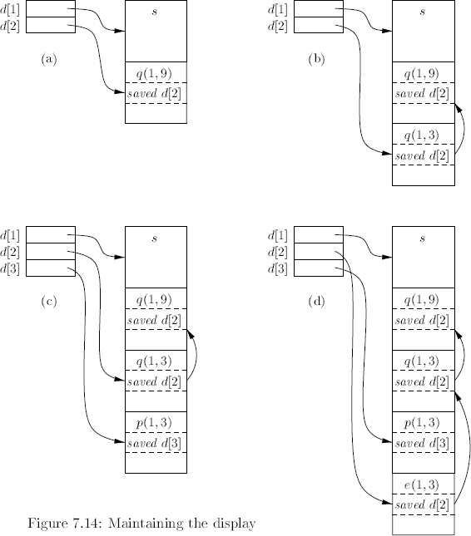
COMPILER DESIGN
Unit 5: Run-Time Environments
Maintaining the Display
d[i] is a pointer to the highest activation record on the stack
for any procedure at nesting depth i.
Example:
In Fig. 7.14(d), we see the display d, with
d[1] holding a pointer to the activation record for sort, the highest (and only) activation record for a function at nesting depth 1.
d[2] holding a pointer to the activation record for exchange,
the highest record at depth 2, and
d[3] points to partition, the highest record at depth 3.

Slide 104
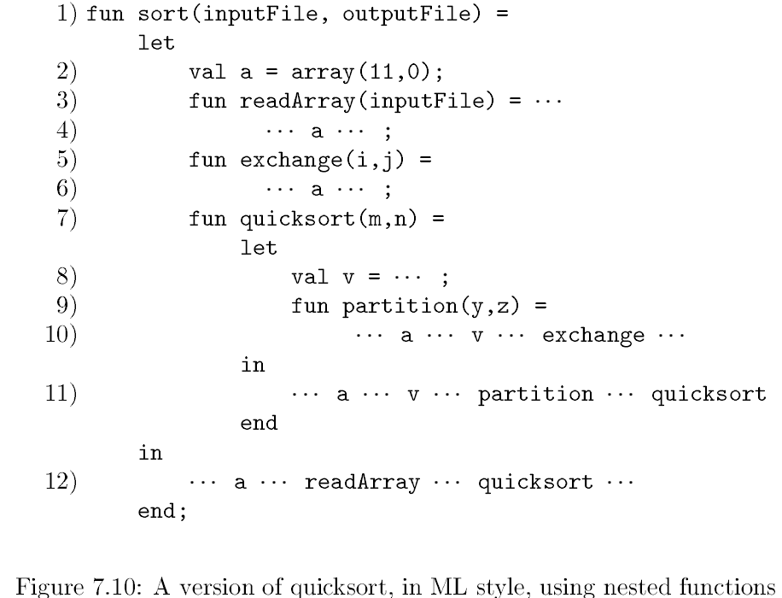
COMPILER DESIGN
Unit 5: Run-Time Environments
Displays
One problem with the access-link approach to nonlocal data is that if the nesting depth gets large, we may have to follow long chains of links to reach the data we need.
A more efficient implementation uses an auxiliary array d, called the
display, which consists of one pointer for each nesting depth.
At all times, d[i] is a pointer to the highest activation record on the stack for any procedure at nesting depth i.
Previous value of d[i] must be stored in the current A.R. with depth i.
Examples of a display are shown in Fig. 7.14.

Slide 105
COMPILER DESIGN
Unit 5: Run-Time Environments
Maintaining the Display
The advantage of using a display is that
Suppose a procedure 𝑝 is executing and needs to access element 𝑥 belonging to procedure 𝑞.
The runtime only needs to search in activations from 𝑑[𝑖],
where 𝑖 is the nesting depth of 𝑞.
Follow the pointer 𝑑[𝑖] to the activation record for 𝑞, wherein 𝑥 should be defined at a known offset.

Slide 106
COMPILER DESIGN
Unit 5: Run-Time Environments
Access Links Vs Displays
Access Links | Displays
Cost of lookup varies Common case is cheap, but long chains can be costly | Cost of lookup is constant
Cost of maintenance also is variable | Cost of maintenance is constant

Slide 107
THANK YOU
Prakash C O
Department of Computer Science and Engineering
coprakasha@pes.edu
+91 98 8059 1946

